Slide 1

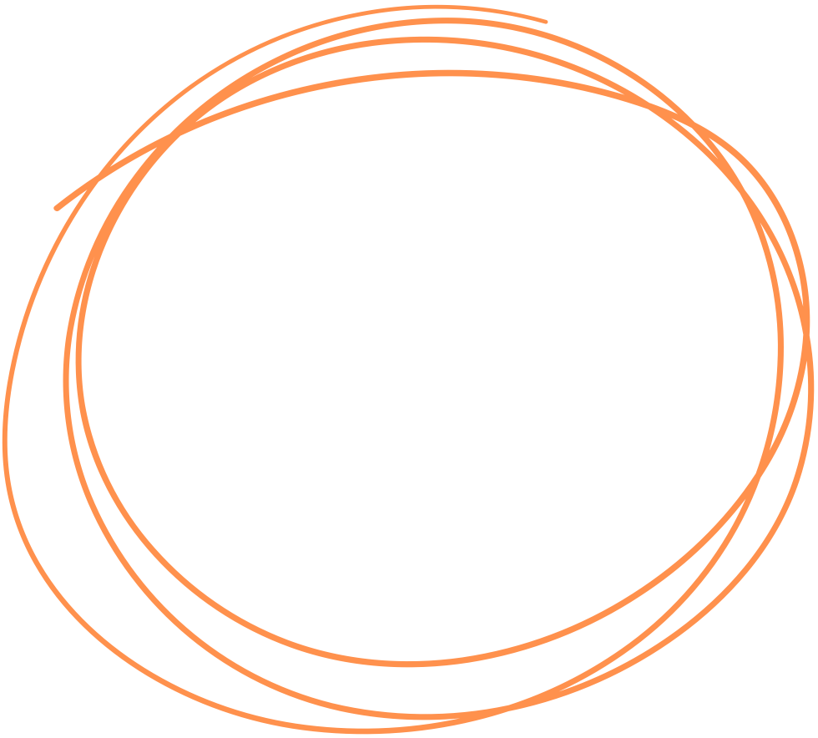

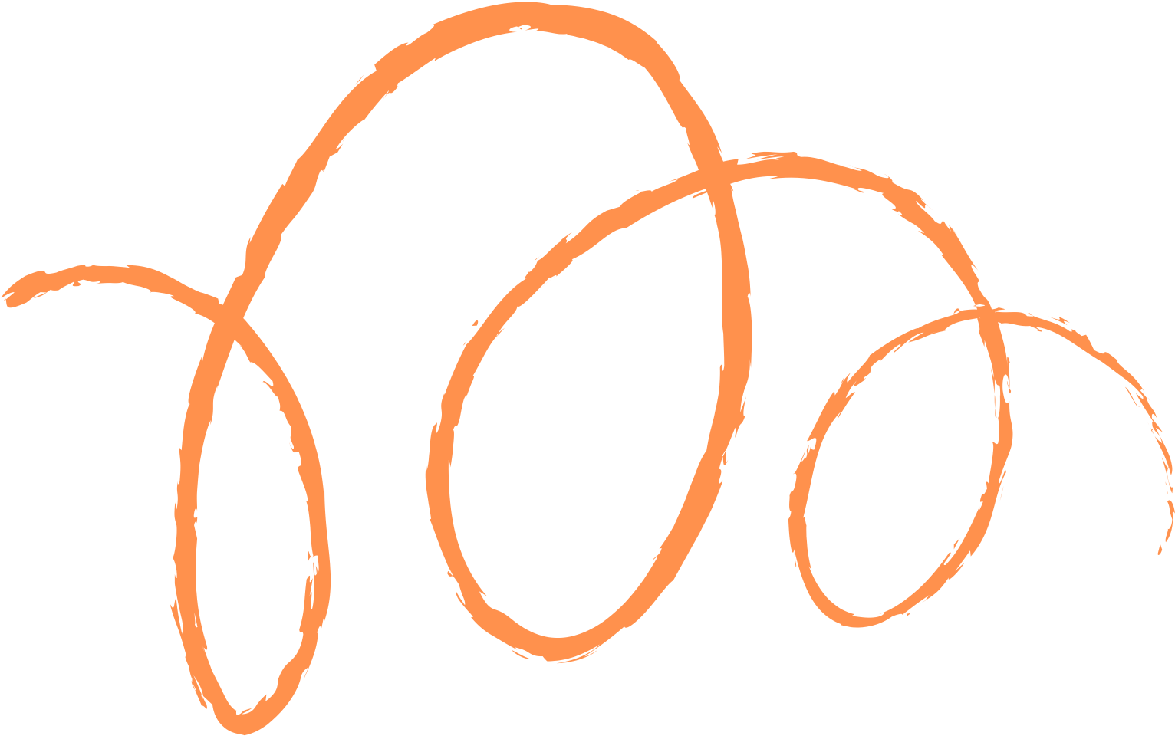








Tekla Structures 3D Optimisation Project Phase IV
Presented by JFC Team 10
The University of Sydney
1

Slide 2
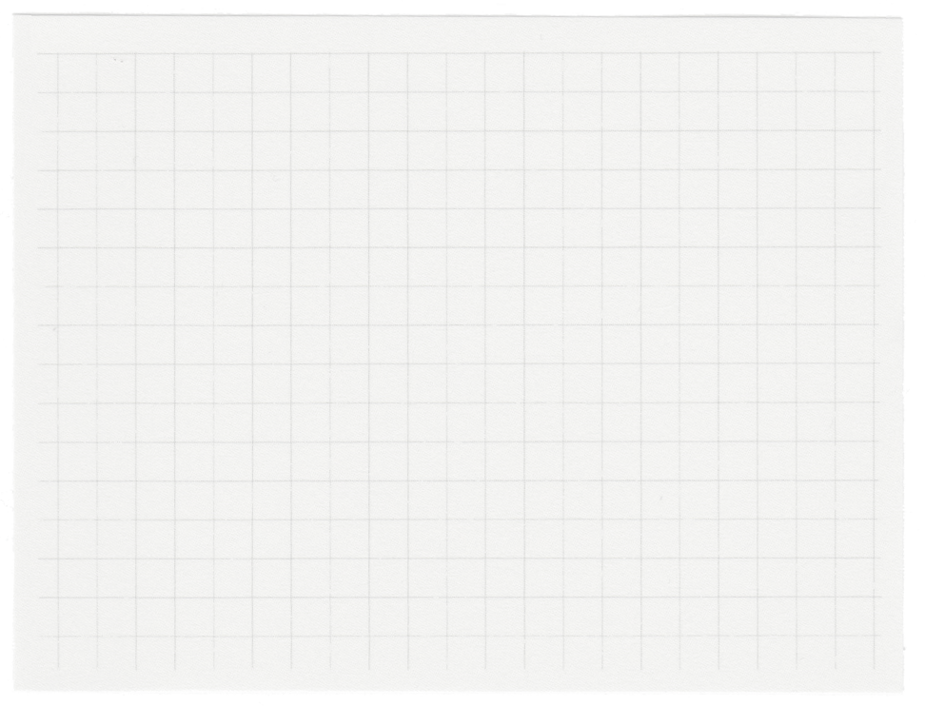
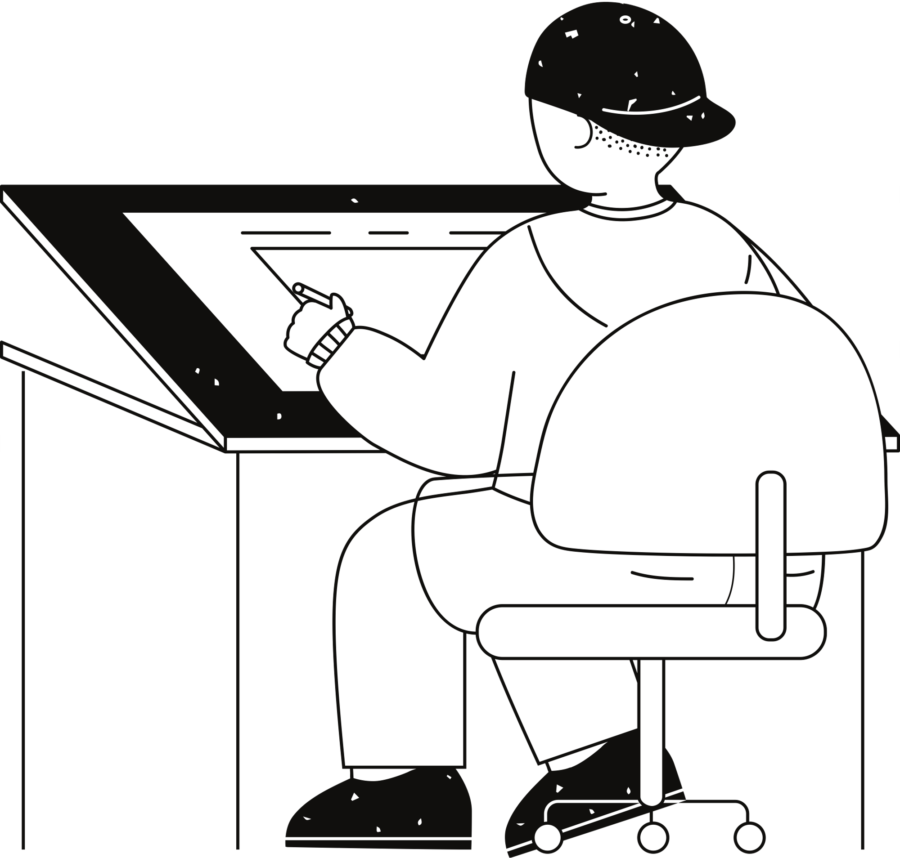
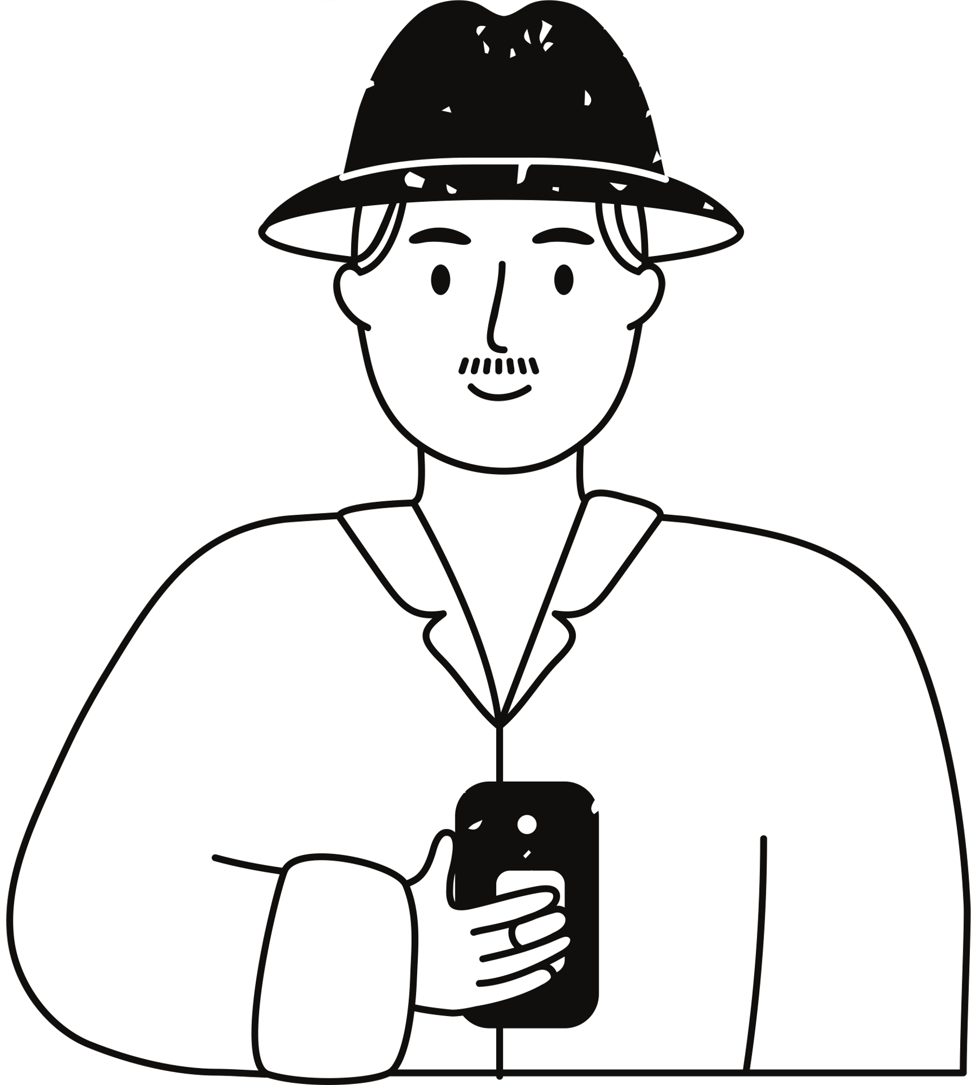
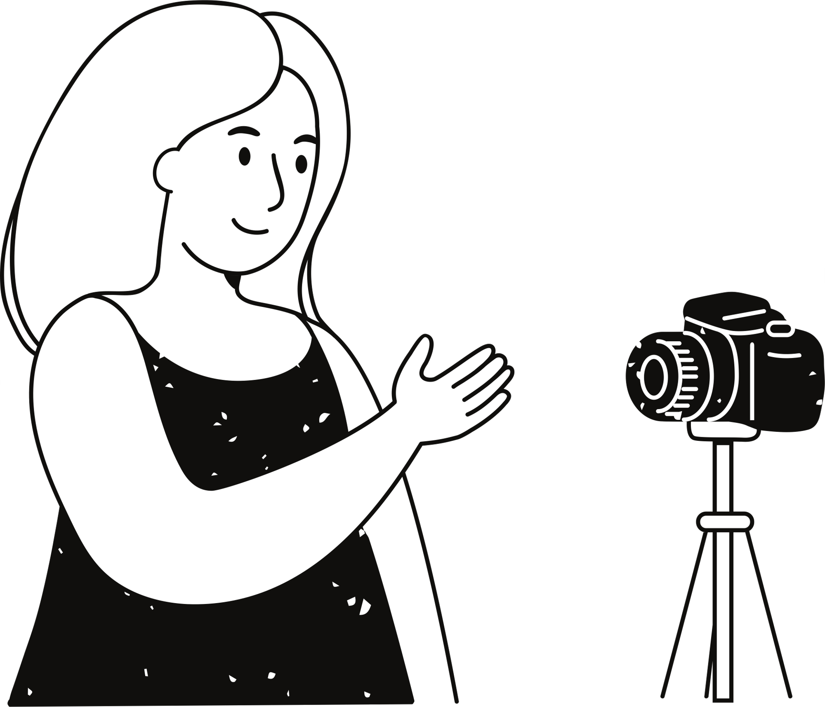

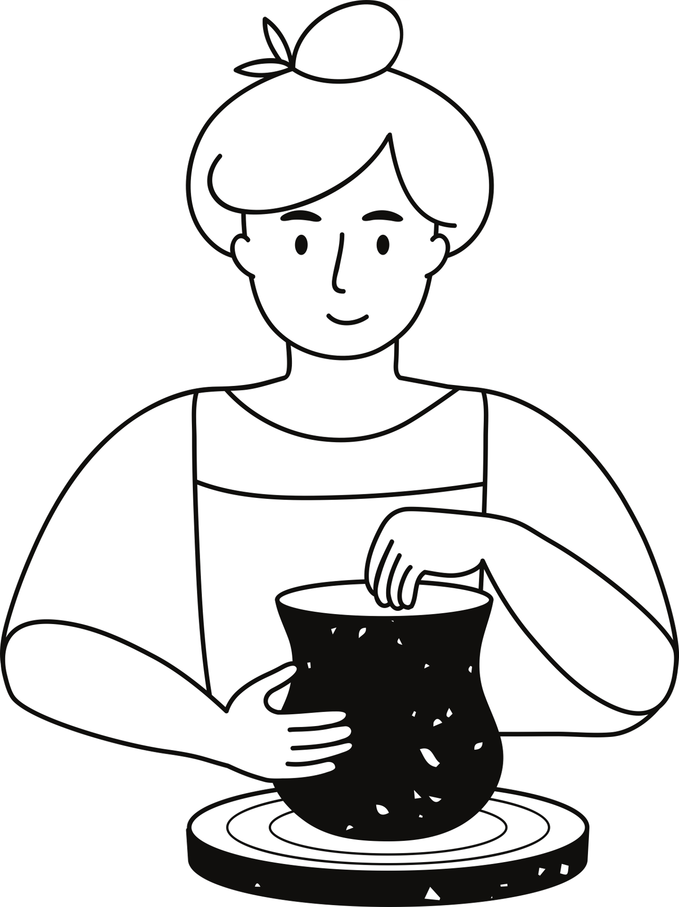

Terry Wang
Zeeshan Ansari
Mechatronic
Engineering
Software Engineering
Team Profile
Ariella Zhao
Mark Sun
Civil
Engineering
Electrical Engineering
Consulting Interns
Josh Ling
Anthony Dumbrell
Civil
Engineering
Supervisor
The University of Sydney
2

Slide 3



Hanlon Industries is the leading billboard manufacturer in Australia
Problem Definition
With the automation of construction modelling, opportunities have been identified
Success will result in cost and time savings
The University of Sydney
3

Slide 4
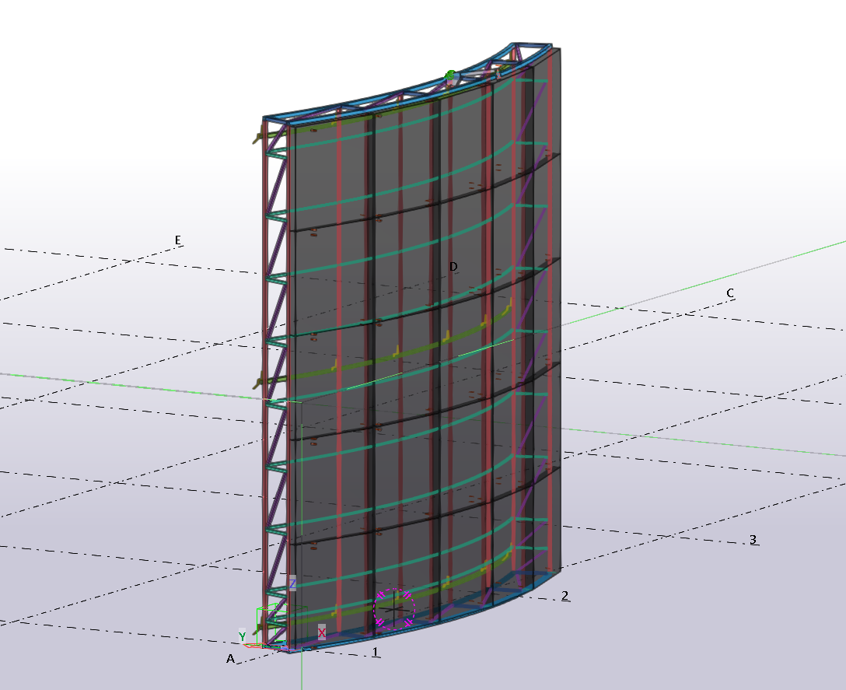
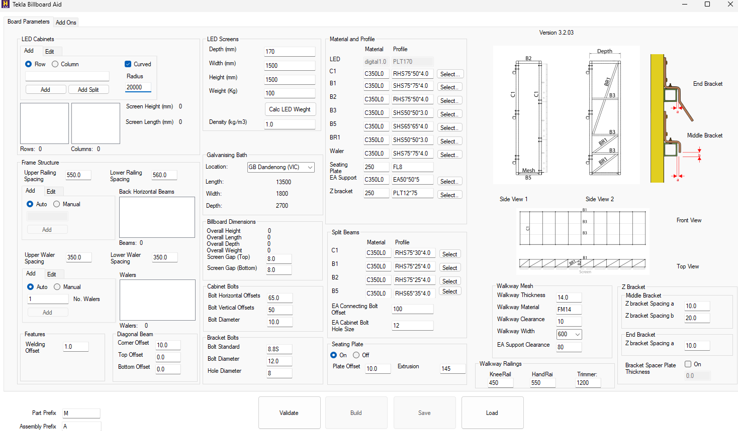
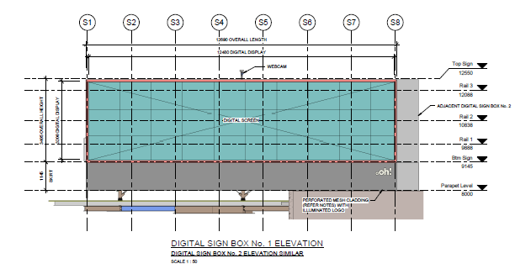
Project Summary
01
02
03
04
Parameters taken from drawings
User inputting parameters
Program automation
Curved billboard
model
Streamline process
The University of Sydney
4

Slide 5
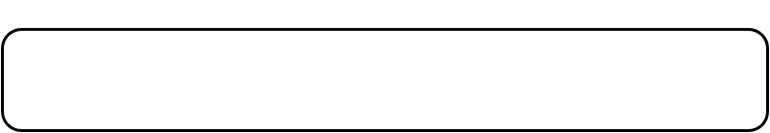
Project Scope
In Scope
In Between Scope
Out of Scope
Integrate all existing features into a curved design
2D braced fascia frame
Galvanising holes for enclosed steel members
Back bracings
Explore and implement further user-interface improvements
Refactor the entire codebase of the flat billboard for optimisation and modularity for future development
The University of Sydney
5

Slide 6

Assumptions
Deliverables
Only horizontal members are curved
Side bracings should remain straight
The billboard only curves convex
The total height and length of the billboard is equal to the sum of the values added for rows and columns
The user is knowledgeable
Phase IV Complete Software Plugin
User Documentation
Technical documentation
Final report
The University of Sydney
6

Slide 7
UI Page 1 (Board parameters)
The University of Sydney
7

Slide 8
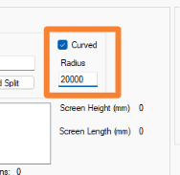
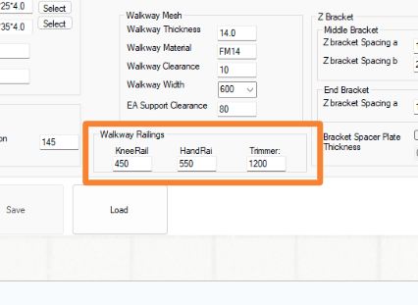
UI Page 1 (Board parameters)

Slide 9
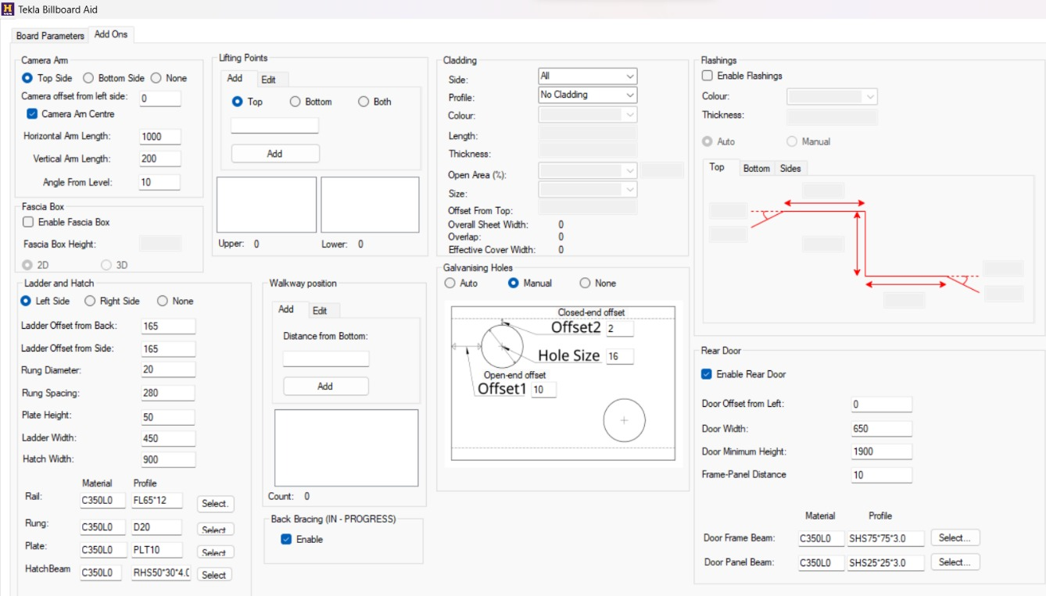
UI Page 2 (Add Ons)
The University of Sydney
8

Slide 10
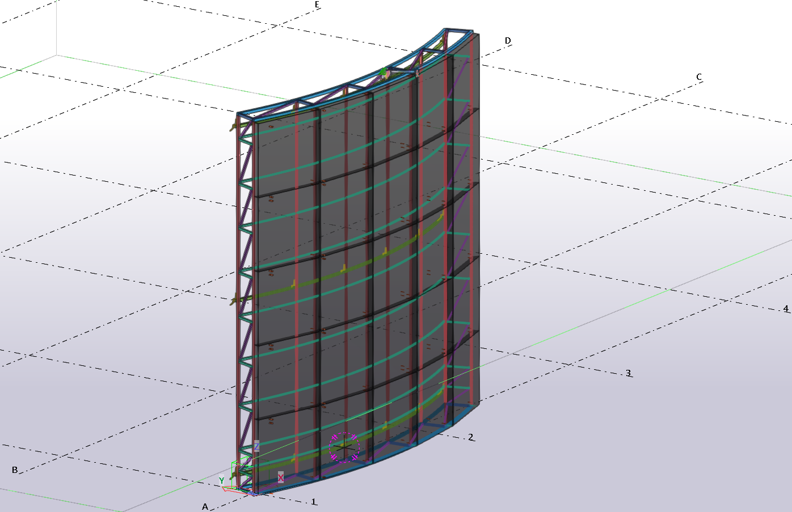
Billboard
The University of Sydney
9

Slide 11
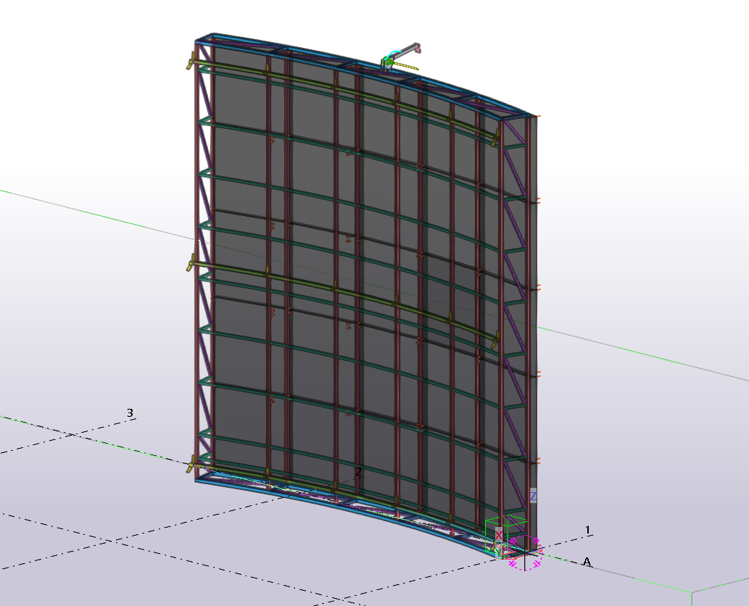
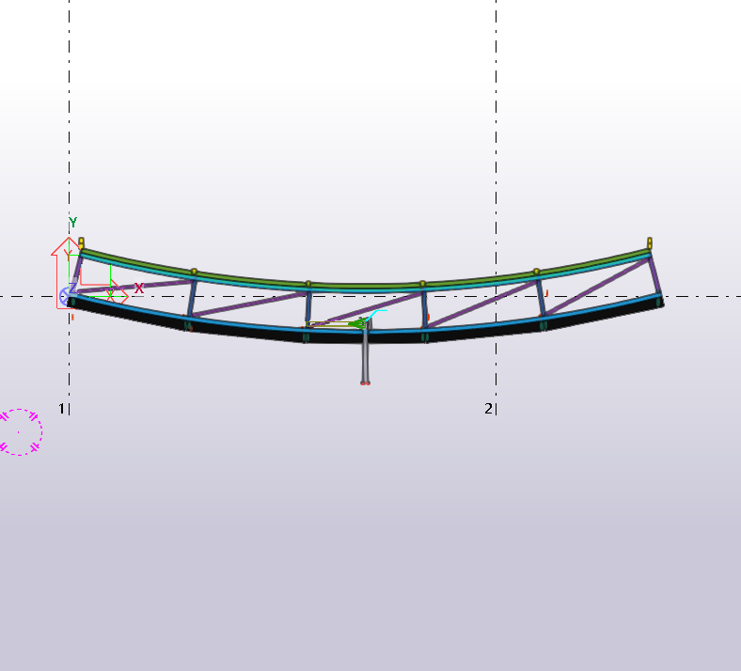
New Features
Basic features of a flat billboard such as base frame, side bracing, LED clearance offset, seating plates, Walers & Z brackets and walkway railings.
1
Curved billboard
The University of Sydney
10

Slide 12

Challenges
01
02
03
04
Unfamiliarity
Understanding previous work
Time constraints
Mathematics
The University of Sydney
11

Slide 13
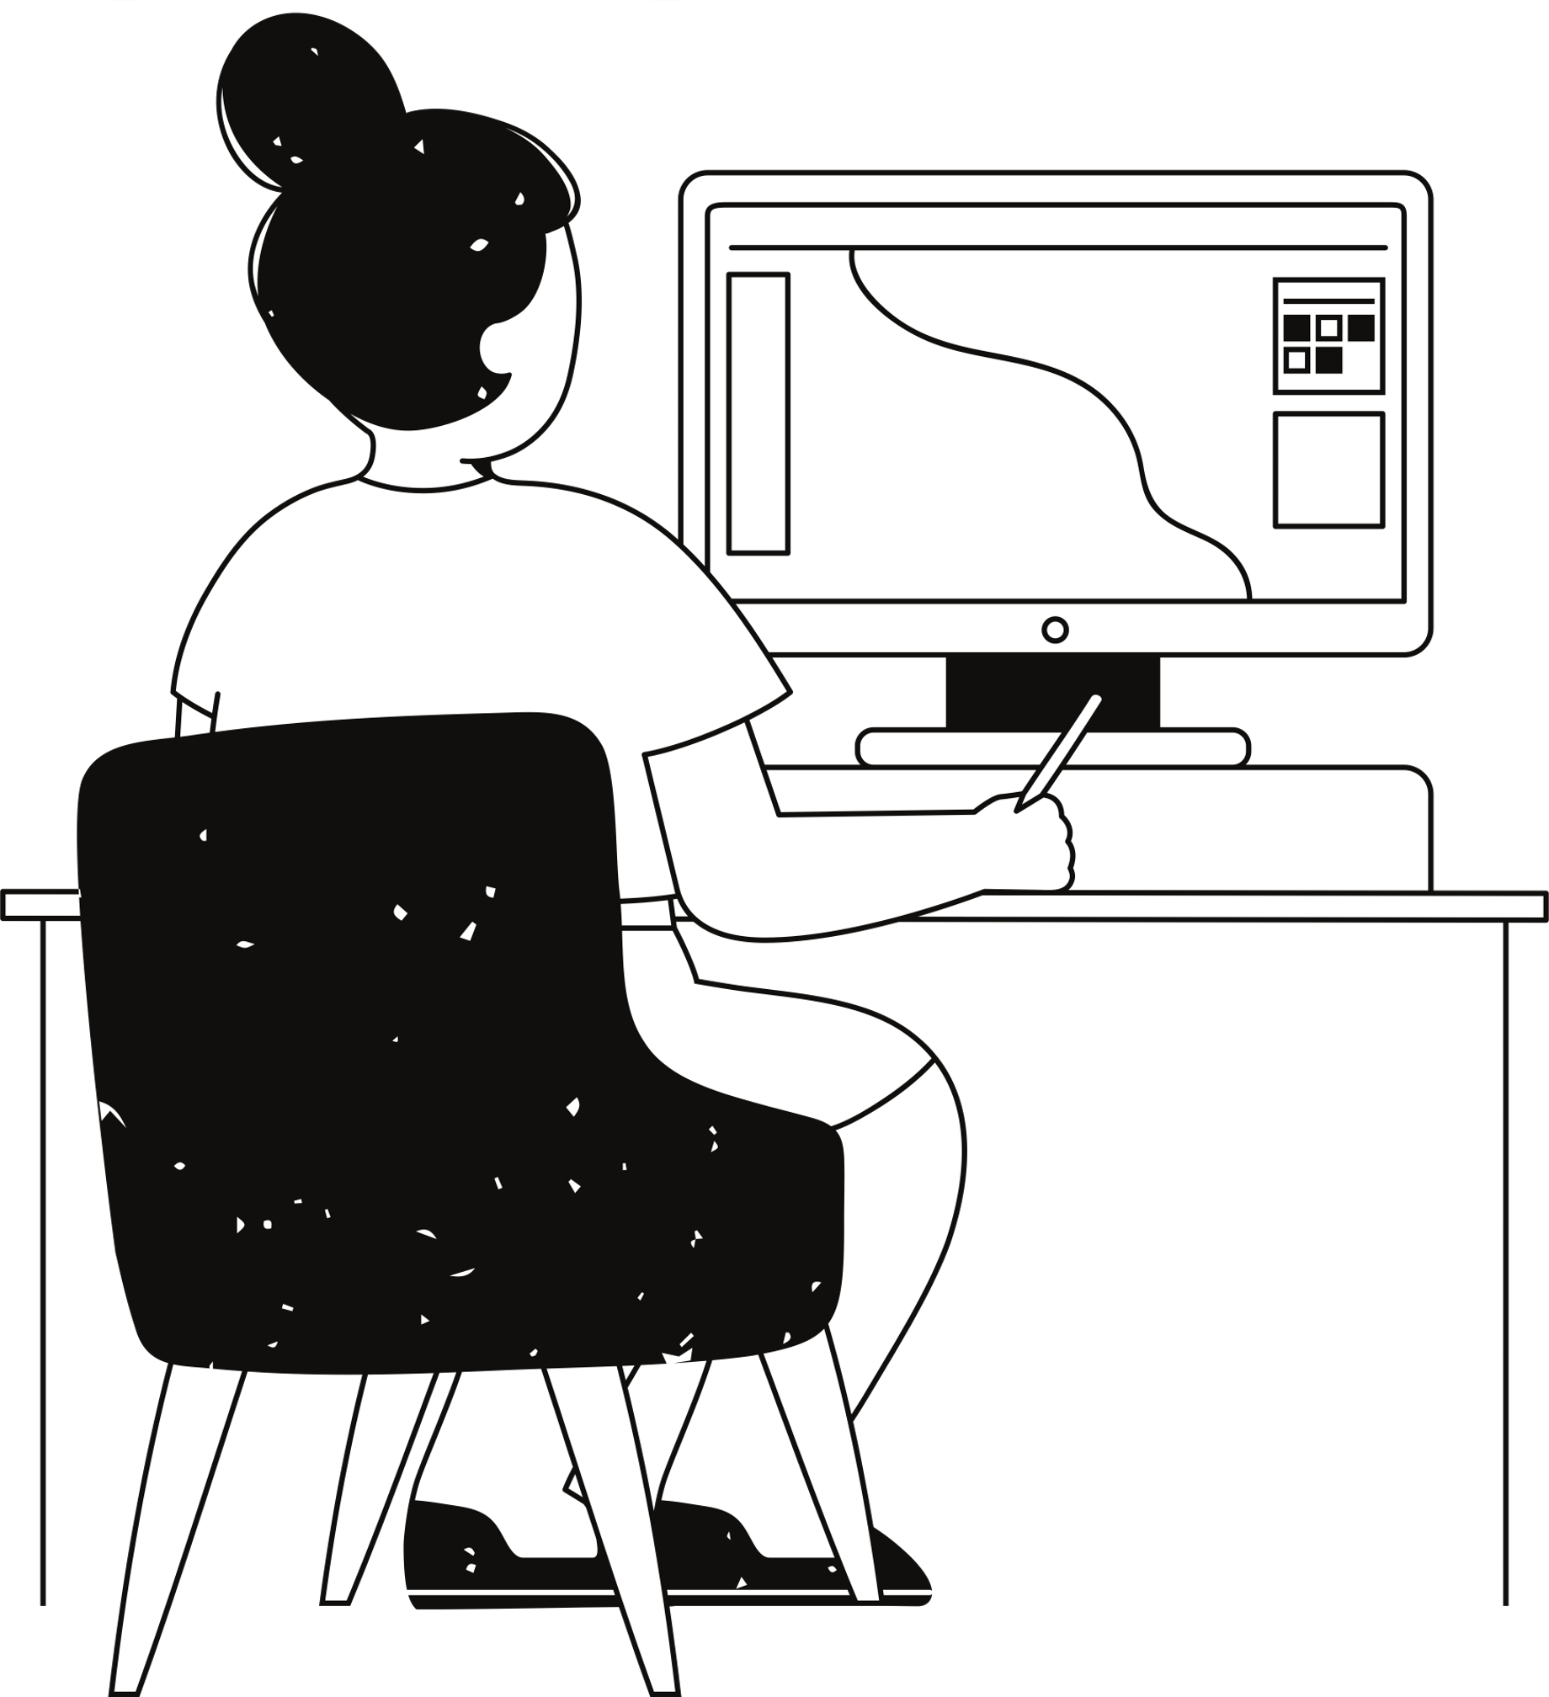
Recommendations for Future Developments
Fix flat billboard bugs
Further develop curved billboard
Revamp UI for ease of use
Refactor code for optimisation and modularity for future development.
The University of Sydney
12

Slide 14
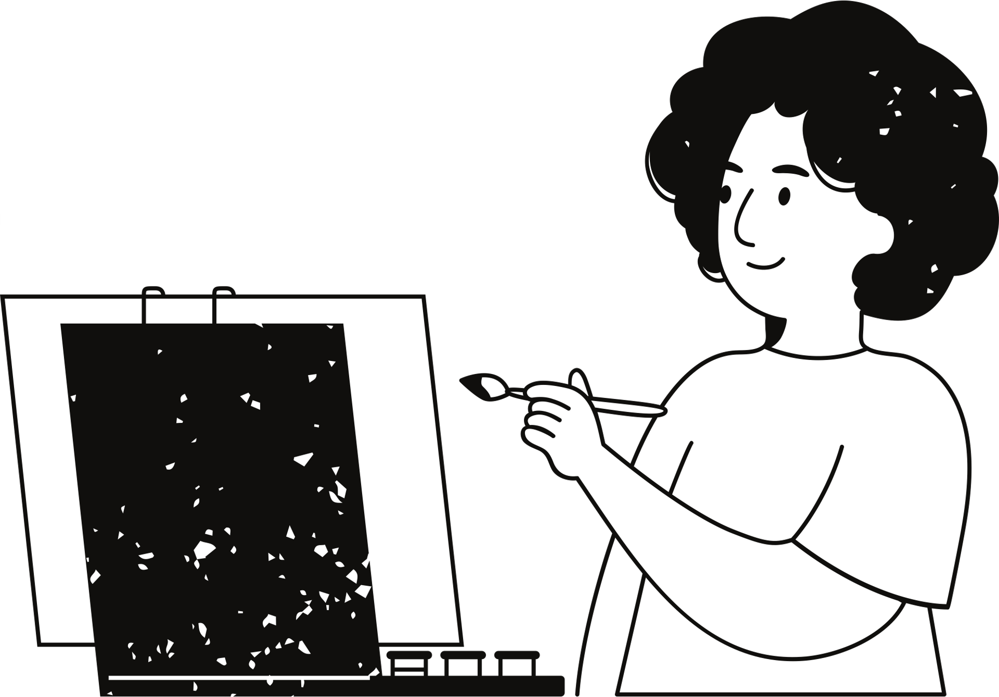
Conclusion
Curved billboard design now in place
Streamline curved billboard drafting at Hanlon
The University of Sydney
13

Slide 15
Demonstration
The University of Sydney
14

Slide 16
Q&A Time
The University of Sydney
15

